Slide 1
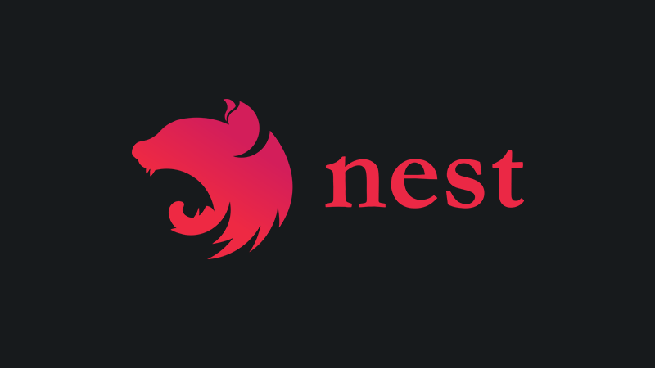
NestJs – A progressive Node.js framework
By Avraham Hamu & Asaf Naory

Slide 2
What are we going to learn?
Introduction and philosophy
Phase 1 – Rest API
General architecture (modules ,Controllers Providers )
Main features (Decorators ,Pipes, Database and Authentication )
Phase 2
Nest and GraphQL
Phase 3
Nest Microservices
Pahse 4
Summary

Slide 3

What is Nestjs?
Notes:
בשנים האחרונות , בזכות נוד js הפכה להיות שחקן מרכזי בזירה של ה BE iFE
ההצלחה הזאת הולידה מספר frameworks מפורסמים ומוצלחים כמו angular vue ו react שמאפשרים להגדיל את פיריון המתכנתים, וגם לכתוב אפליקציות , בצורה יותר זריזה , מסודרת ומודולריות.
למרות ההצלחה הזאת ולמרות eco system מאוד עשיר עם מלא ספריות, עדיין ישנם בעיה אחת, בעיה של architecture
Nest
בא כדי לפתור את הבעייה הזאת , הוא מספק פיטרון out of the box של server application הכולל scalability ‘ testability ‘ צמידות נמוכה ותחזוקה קלה. ה architecture קיבל השרה מ angular
בנוי על TS מאחורי הקלאים הוא כולו מבוסס על express by default ותומך גם ב fastify

Slide 4




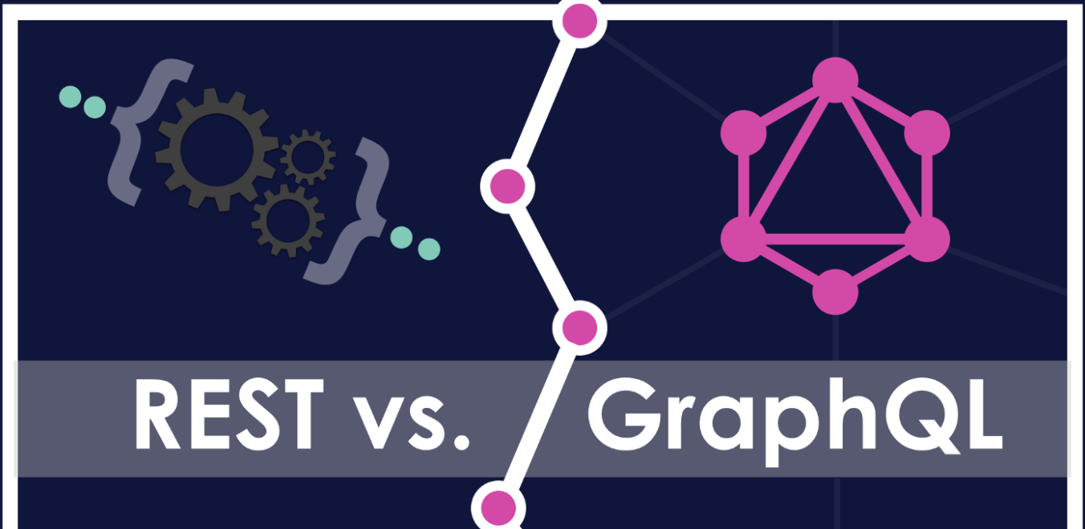
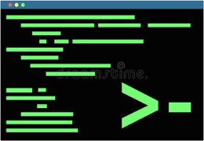
Why care about NestJS ?
Type checking
Application architecture
Dependency injection
Testable
Rest and graphQL
Command-line interface (cli)
Notes:
עכשיו שכולנו יודעים מה זה nest נשאר לנו להבין למה כדאי להשתמש בו!
מבוסס TS שמאפשר לגלות שגיאות בזמן כתיבה ולא בזמן הרצה fail fast

Slide 5
Why care about NestJS ?
Type checking
Application architecture
Dependency injection
Testable
Rest and graphQL
Command-line interface (cli)
Notes:
הוא design patterrn שמאפשר מודולריות בכתיבת אפליקציות, הוא עוזר לנו למשור על קוד נקי , מעודד שימוש חוזר של קוד , ומגיע מובנה בתוך nest. לא צריך לקנפג שום דבר

Slide 6
Why care about NestJS ?
Type checking
Application architecture
Dependency injection
Testable
Rest and graphQL
Command-line interface (cli)
Notes:
Rest and graphQL: Can be used to build REST apis and GraphQL apis (builds a wrapper above Apollo)

Slide 7
Why care about NestJS ?
Type checking
Application architecture
Dependency injection
Testable
Rest and graphQL
Command-line interface (cli)
Notes:
כמו שאמרנו מקודם כולו בנוי כמו אנגולר עם אותם אבני בנייה module, service, controller, pipe, decorators same syntax same philosophy
האיתרון המרכזי בלעבוד עם architecture מוגדרת מראש זה שימוש ב best practices ותחזוקה ידידותית למרות הכל הוא דיין מאוד גמיש ולא קובל מתכנתים

Slide 8
Why care about NestJS ?
Type checking
Application architecture
Dependency injection
Testable
Rest and graphQL
Command-line interface (cli)
Notes:
Testable: NestJS provides a full Jest testing configuration out of the box but still allows us developers to use other testing tools as we see fit

Slide 9
Why care about NestJS ?
Type checking
Application architecture
Dependency injection
Testable
Rest and graphQL
Command-line interface (cli)
Notes:
CLI: Nestjs gives a cli which you can create project, module, services in an easy way with

Slide 10
What are we going to learn?
Introduction and philosophy
Phase 1 – Rest API
General architecture (modules ,Controllers Providers )
Main features (Decorators ,Pipes, Database and Authentication )
Phase 2
Nest and GraphQL
Phase 3
Nest Microservices
Phase 4
Summary

Slide 11
Modules
In Angular, a module is a mechanism to group components, directives, pipes and services that are related, in such a way that can be combined with other modules to create an application. An Angular application can be thought of as a puzzle where each piece (or each module) is needed to be able to see the full picture.
Notes:
In Angular, a module is a mechanism to group components, directives, pipes and services that are related, in such a way that can be combined with other modules to create an application. An Angular application can be thought of as a puzzle where each piece (or each module) is needed to be able to see the full picture.

Slide 12
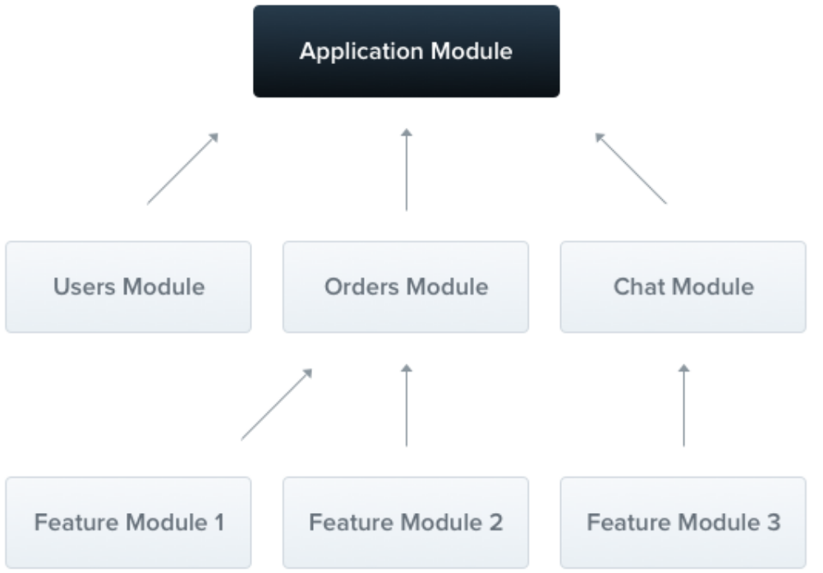
Modules
The resulting architecture will employ multiple modules, each encapsulating a closely related set of capabilities.
Notes:
Each application has at least one module, a root module.
The root module is the starting point Nest uses to build the application graph - the internal data structure Nest uses to resolve module and provider relationships and dependencies.
We want to emphasize that modules are strongly recommended as an effective way to organize your components. Thus, for most applications, the resulting architecture will employ multiple modules, each encapsulating a closely related set of capabilities.
מה זה מודול ? זה יחדה לוגית שמקבצת כל השחקנים שמשרתים מטרה אחת.
כל אפליקציה בנויה לפחות ממודול אחד ה root module שהוא הנקודת התחלה של האפליקציה. Nest מעודדים שימוש רחב של מודולים כדי לבנות application graph
שהוא סוג של "תצוגת היחוס"
של האפליקציה

Slide 13
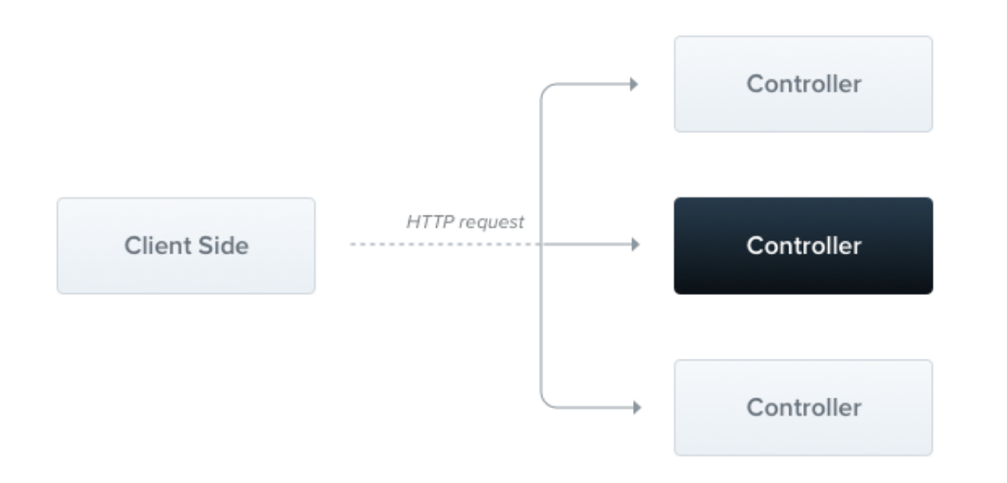
Controllers
Controllers are responsible for handling incoming requests and returning responses to the client.
Notes:
Add red frame
Controllers are responsible for handling incoming requests and returning responses to the client.
A controller's purpose is to receive specific requests for the application. The routing mechanism controls which controller receives which requests. Frequently, each controller has more than one route, and different routes can perform different actions.
Controller הוא אחראי על תיפול בבקשות נכנסות מה client ותפקיד המרכזי שלו הוא לנווט את הבקשות ליחידת טיפול יעודית , הוא מחזיק את טבלת ה routing

Slide 14
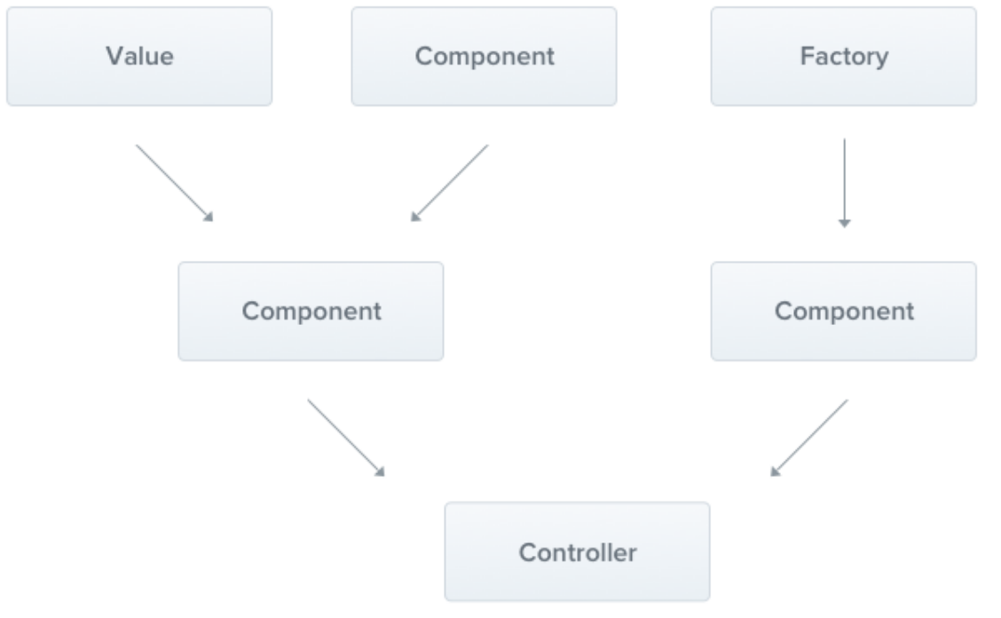
Providers
The main idea of a provider is that it can inject dependencies
Notes:
Providers are a fundamental concept in Nest. Many of the basic Nest classes may be treated as a provider – services, repositories, factories, helpers, and so on.
The main idea of a provider is that it can inject dependencies; this means objects can create various relationships with each other, and the function of "wiring up" instances of objects can largely be delegated to the Nest runtime system.
Provider הוא מרכיב הכי חשוב , הוא כל מה שהוא בר הזרקה services, repositories, factories, helpers
ולרוב שמה נכתוב את רוב הקוד שלנו
בסוף בעזרת ה DI נאסט לוקח את ה providers ויוצר חיווט של האפליקציה.

Slide 15
What are we going to learn?
Introduction and philosophy
Phase 1 – Rest API
General architecture (Modules ,Controllers Providers )
Main features (Decorators ,Pipes, Database and Authentication )
Phase 2
Nest and GraphQL
Phase 3
Nest Microservices
Phase 4
Summary

Slide 16

Notes:
?? TODO explain more about decorator
// large lecture: guard, dto, db
Decorators are functions that are invoked with a prefixed @symbol. Those provides additional metadata about the class.

Slide 17
What are we going to learn?
Introduction and philosophy
Phase 1 – Rest API
General architecture (Modules ,Controllers Providers )
Main features (Decorators ,Pipes, Database and Authentication )
Phase 2
Nest and GraphQL
Phase 3
Nest Microservices
Phase 4
Summary
Notes:
// TODO: pipes

Slide 18
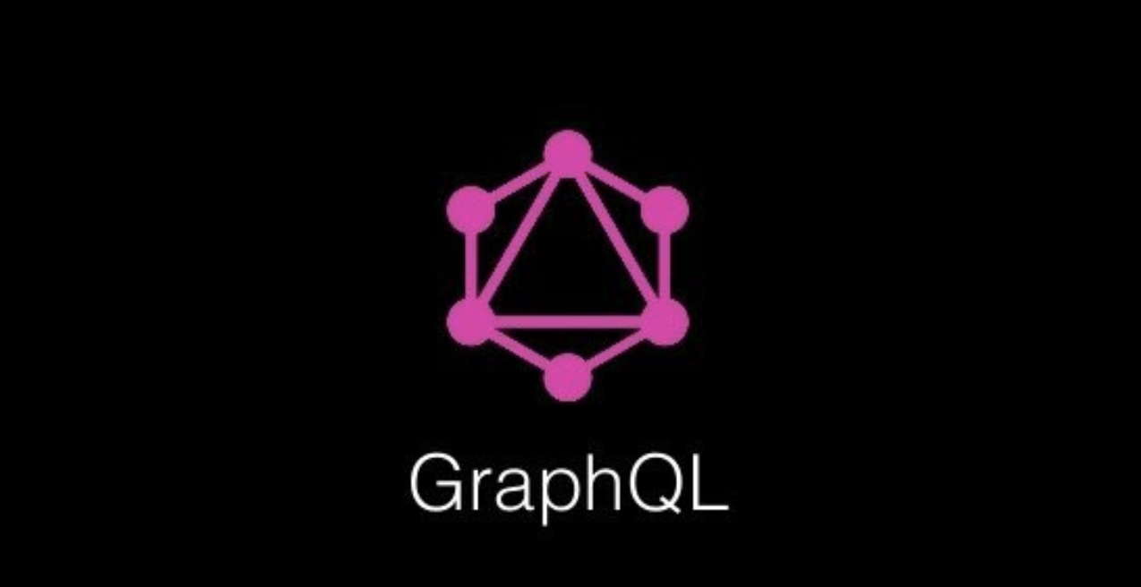
Notes:
GraphQL is an open sourced API specification from Facebook that is touted as the next evolution from RESTful APIs. The primary benefits at a high level is a reduction in how many times an endpoint (or multiple endpoints) are called to get only the information that is requested. In doing so, solves the problem of over and under fetching in the JSON payload. Hold the pickles, thank you.
Often, GraphQL is presented as a revolutionary new way to think about APIs. Instead of working with rigid server-defined endpoints, you can send queries to get exactly the data you’re looking for in one request.
Esch request is post
Mutation: create /post patch put
Query : get
Graphql היא שפה של שאילתות עבור ה api מפותחת ע״י facebook c 2012 ושוחרר לקהל הרחב ב 2015.
השאילתות האלו מאפשרות ל client לשלות במה שחוזר מהשרת.
במקום לעבוד עם פורמט קבוע של תשובה שחוזרת מהשרת אפשר לרדת לרזולוציה יותר נמוכה.
מיד אציג דוגמה:
נניח שאני רוצה להציג באיזה אפליקציה של בלוג הכותרות של משתמש ספציפי . באותו מסך אני רוצה להציג גם את השמות של 3 followers
איך פותרים את זה ב rest?
https://www.howtographql.com/basics/1-graphql-is-the-better-rest/
לפני שנעבור לקןד בוא נזרוק עןד כמה מושגים על nest

Slide 19
Create: POST
READ: GET
UPDATE: PUT, PATCH
DELETE: DELETE
Notes:
Write restfull and graphql in same files

Slide 20
A Query is a read-only operation made against a GraphQL server
A Mutation is a read-write operation made against a GraphQL server.
A Resolver provides a mapping between a portion of a GraphQL operation and actual backend code responsible for handling it (similar to a controller in a RESTful MVC backend).
A Schema defines what queries and mutations can be performed against a GraphQL server, what each query or mutation takes as input, and what each query or mutation returns as output.
A Type defines the shape of output / response data that can be returned from the GraphQL server, including fields that are edges to other Types.
An Input is like a Type, but defines the shape of input data that is sent to a GraphQL server.
A Scalar is a primitive Type, such as a String, Int, Boolean, Float, etc.

Slide 22
What are we going to learn?
Introduction and philosophy
Phase 1 – Rest API
General architecture (Modules ,Controllers Providers )
Main features (Decorators ,Pipes, Database and Authentication )
Phase 2
Nest and GraphQL
Phase 3
Nest Microservices
Phase 4
Summary

Slide 23

היה
Notes:
GraphQL is an open sourced API specification from Facebook that is touted as the next evolution from RESTful APIs. The primary benefits at a high level is a reduction in how many times an endpoint (or multiple endpoints) are called to get only the information that is requested. In doing so, solves the problem of over and under fetching in the JSON payload. Hold the pickles, thank you.
Often, GraphQL is presented as a revolutionary new way to think about APIs. Instead of working with rigid server-defined endpoints, you can send queries to get exactly the data you’re looking for in one request.
Esch request is post
Mutation: create /post patch put
Query : get
an app needs to display the titles of the posts of a specific user. The same screen also displays the names of the last 3 followers of that user. How would that situation be solved with REST and GraphQL?
https://www.howtographql.com/basics/1-graphql-is-the-better-rest/

Slide 24
What are we going to learn?
Introduction and philosophy
Phase 1 – Rest API
General architecture (Modules ,Controllers Providers )
Main features (Decorators ,Pipes, Database and Authentication )
Phase 2
Nest and GraphQL
Phase 3
Nest Microservices
Phase 4
Summary

Slide 25
Summary

Slide 26
What are we going to learn?
Introduction and philosophy
Phase 1 – Rest API
General architecture (Modules ,Controllers Providers )
Main features (Decorators ,Pipes, Database and Authentication )
Phase 2
Nest and GraphQL
Phase 3
Nest Microservices
Phase 4
Summary

Slide 27
Expande youre knowledge in NestJs! Come to NestJs course! Thank You!

